Slide 1
Searching for Solutions-uninformed search techniques

Slide 2
Outline
Introduction
Basic uninformed search algorithms

Slide 3
INTRODUCTION
Problem can described by
Initial state
Operator or successor function
State space
Path
Goal test

Slide 4
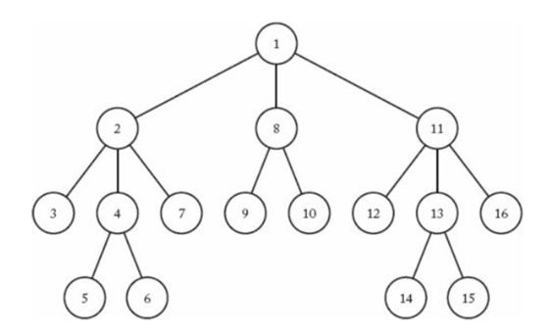
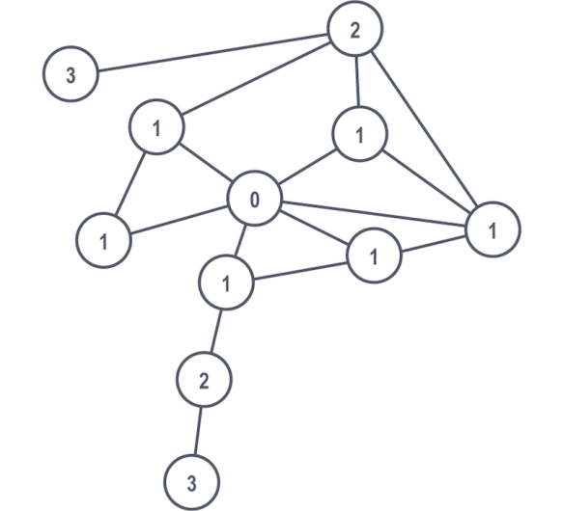
Searching for Solutions
Search Tree
Search Graph

Slide 5
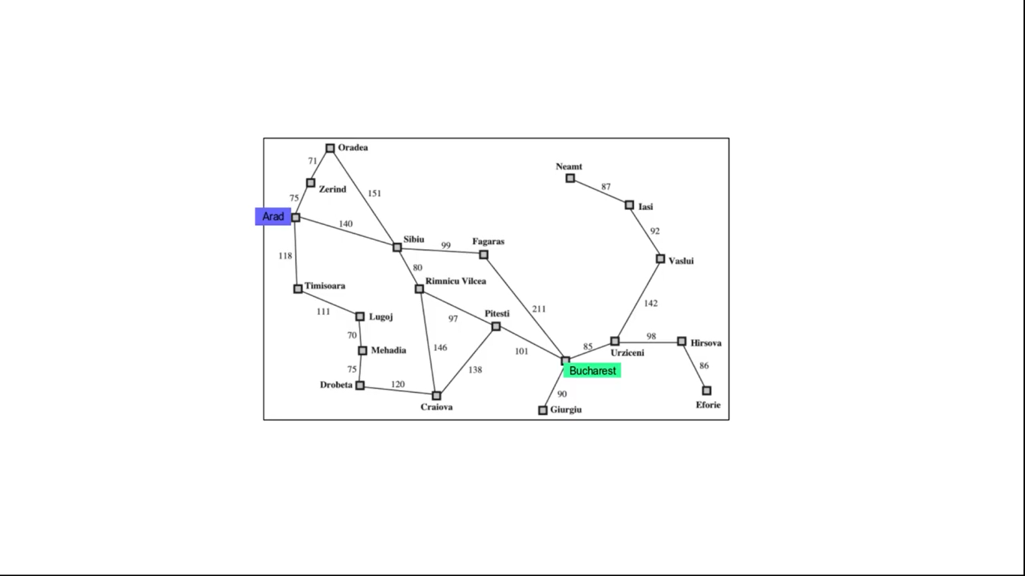
Route finding problem

Slide 6
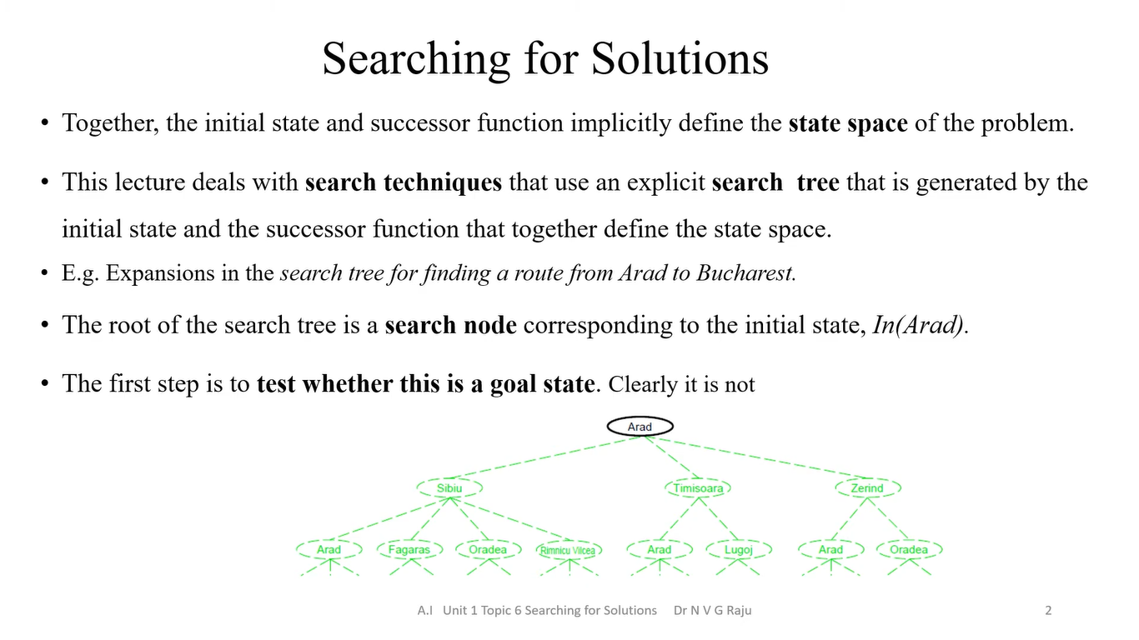

Slide 7
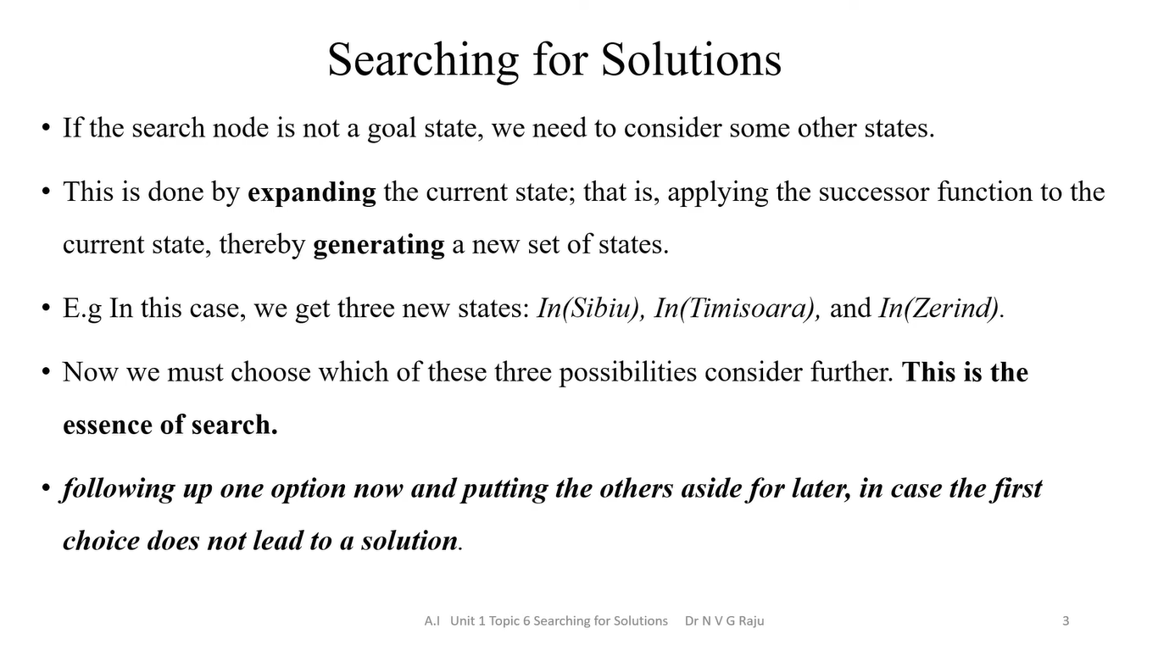

Slide 8
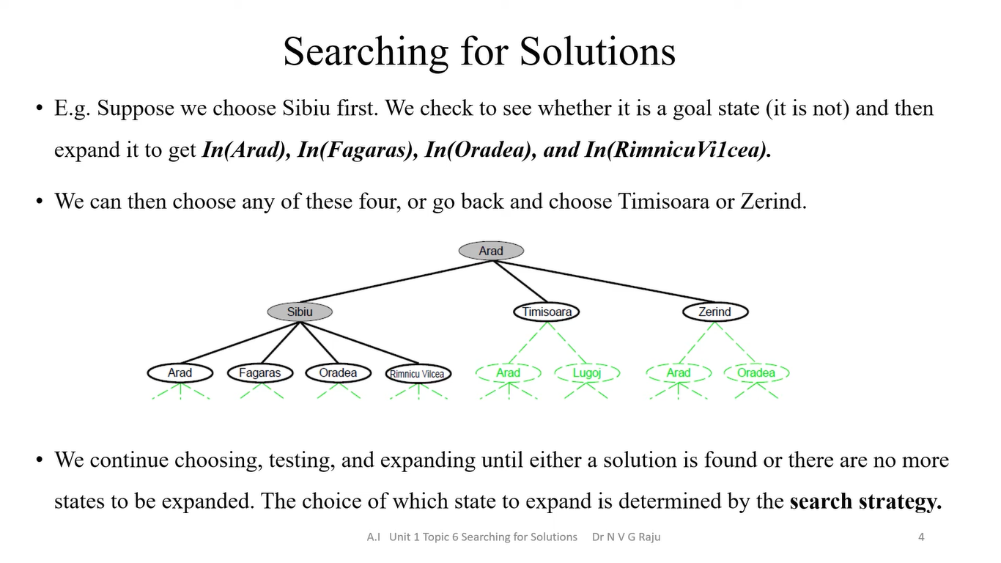

Slide 9
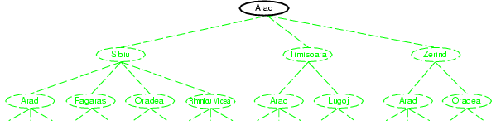
Tree search example

Slide 10
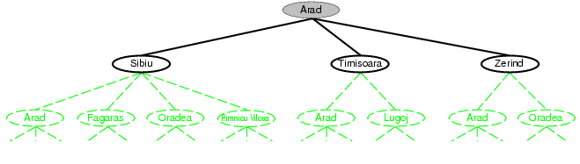
Tree search example

Slide 11
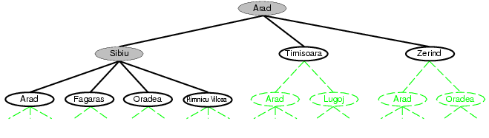
Tree search example

Slide 12
Representation of nodes
STATE: the state in the state space to which the node corresponds;
PARENT: the node in the search tree that generated this node;
ACTION: the action that was applied to the parent to generate the node;
PATH-COST: the cost, traditionally denoted by g(n), of the path from the initial state to the node, as indicated by the parent pointers.

Slide 13
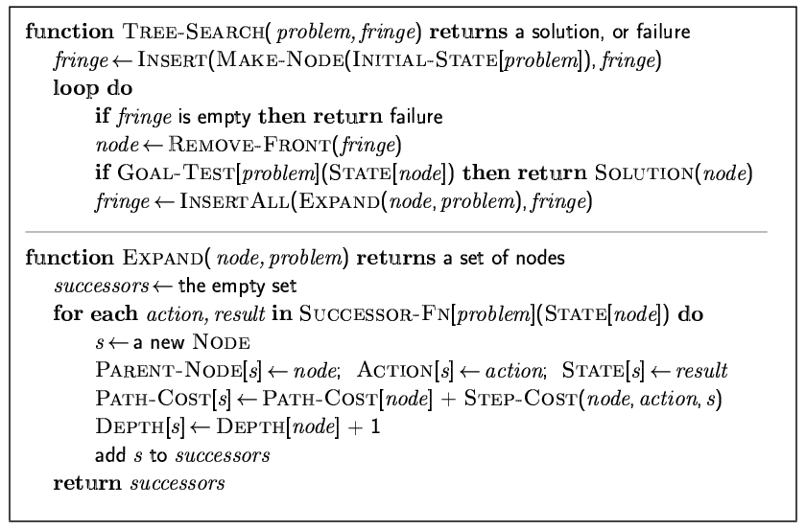
Implementation: general tree search

Slide 14
Key concepts in search
Suppose choose Sibiu first.
Check to see whether it is a goal state (it is not) and then expand it to get In(Arad), In(Fagaras), In(Oradea), and In(RimnicuVilcea).
Then choose any of these four or go back and choose Timisoara or Zerind.
Each of these six nodes is a leaf node, a node with no children in the tree.
Set of all leaf nodes available for expansion at any given point is called the frontier.
Process of expanding nodes on the frontier continues until either a solution is found or there are no more states to expand.
Search algorithm vary primarily according to how they choose which state to expand next— so-called search strategy.
In(Arad) is a repeated state in the search tree, generated in this case by a loopy path - Special case of redundant paths

Slide 15
Infrastructure for search algorithms
Frontier needs to be stored - the search algorithm can easily choose the next node to expand according to its preferred strategy.
Appropriate data structure for this is a queue.
Operations on a queue are as follows:
EMPTY?(queue) returns true only if there are no more elements in the queue.
POP(queue) removes the first element of the queue and returns it.
INSERT(element, queue) inserts an element and returns the resulting queue.
Queues are characterized by the order of stored nodes.
Common variants are
FIFO QUEUE or FIFO queue, which pops the oldest element of the queue;
LIFO QUEUE the last-in, first-out or LIFO queue (stack); and
the priority queue, pops the element of the queue with the highest priority
Explored set can be implemented using hash table to allow efficient checking for repeated states.

Slide 16
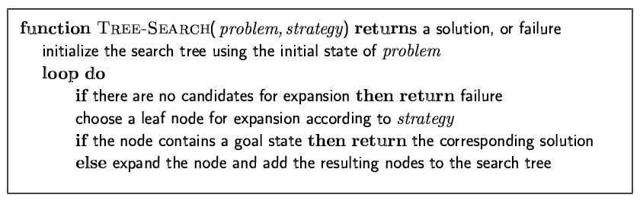
Tree search algorithms
Basic idea:
Search node – Expanding - Generating

Slide 17
Search strategies
A search strategy is defined by picking the order of node expansion
Strategies are evaluated along the following dimensions:
completeness: does it always find a solution if one exists?
time complexity: number of nodes generated
space complexity: maximum number of nodes in memory
optimality: does it always find a least-cost solution?
Time and space complexity are measured in terms of
b: maximum branching factor of the search tree
d: depth of the least-cost solution
m: maximum depth of the state space (may be ∞)

Slide 18
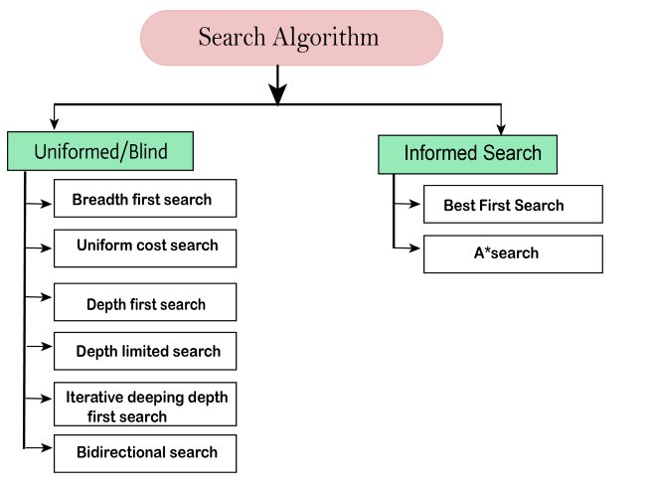
Search Algorithms in AI

Slide 19
Cont…
Uninformed search algorithms have no additional information on the goal node other than the one provided in the problem definition. The plans to reach the goal state from the start state differ only by the order and length of actions.
Informed Search algorithms have information on the goal state which helps in more efficient searching. This information is obtained by a function that estimates how close a state is to the goal state.

Slide 20
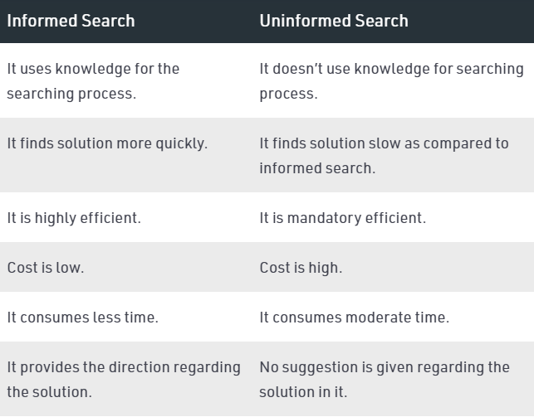
Cont…

Slide 21
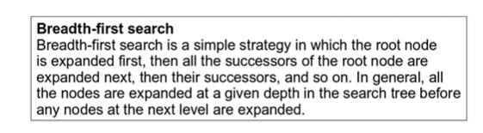
Breadth First Search (BFS)
Breadth-First Search algorithm is a graph traversing technique, where you select a random initial node (source or root node) and start traversing the graph layer-wise in such a way that all the nodes and their respective children nodes are visited and explored.
Breadth-first search implemented using FIFO queue data structure.
A queue is an abstract data structure that follows the First-In-First-Out methodology (data inserted first will be accessed first). It is open on both ends, where one end is always used to insert data (enqueue) and the other is used to remove data (dequeue).

Slide 22
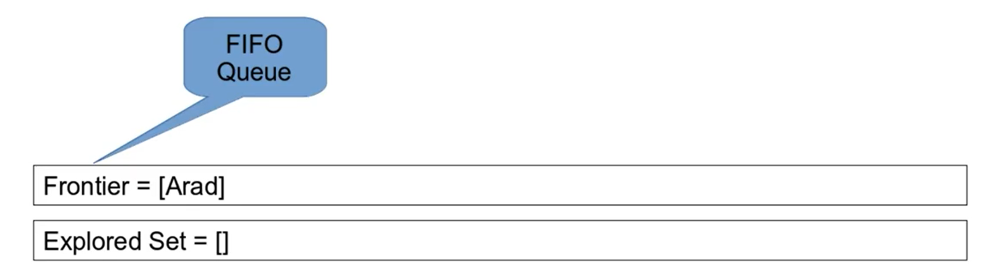

Slide 23
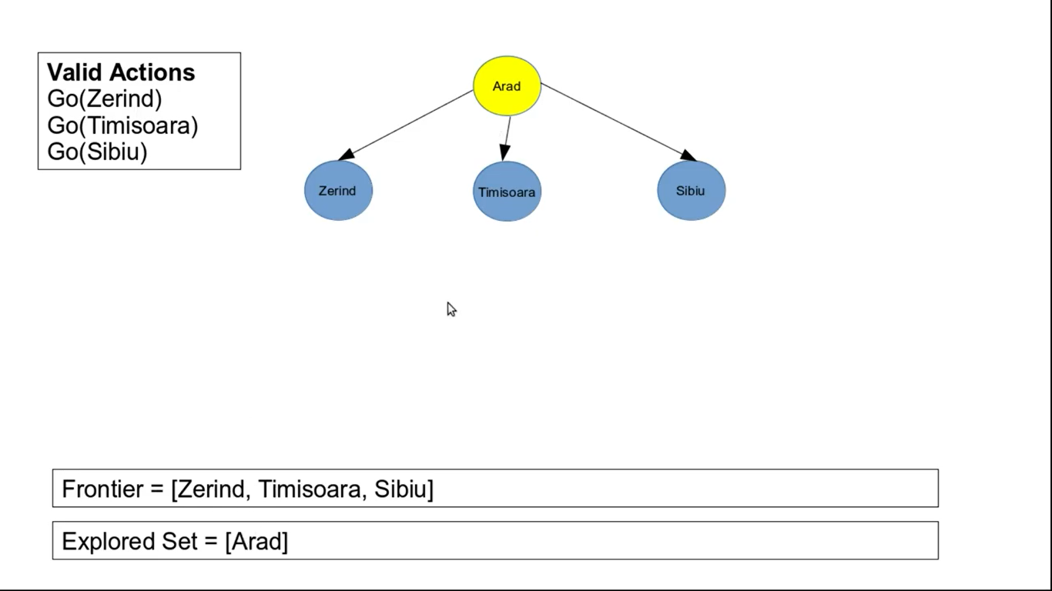

Slide 24
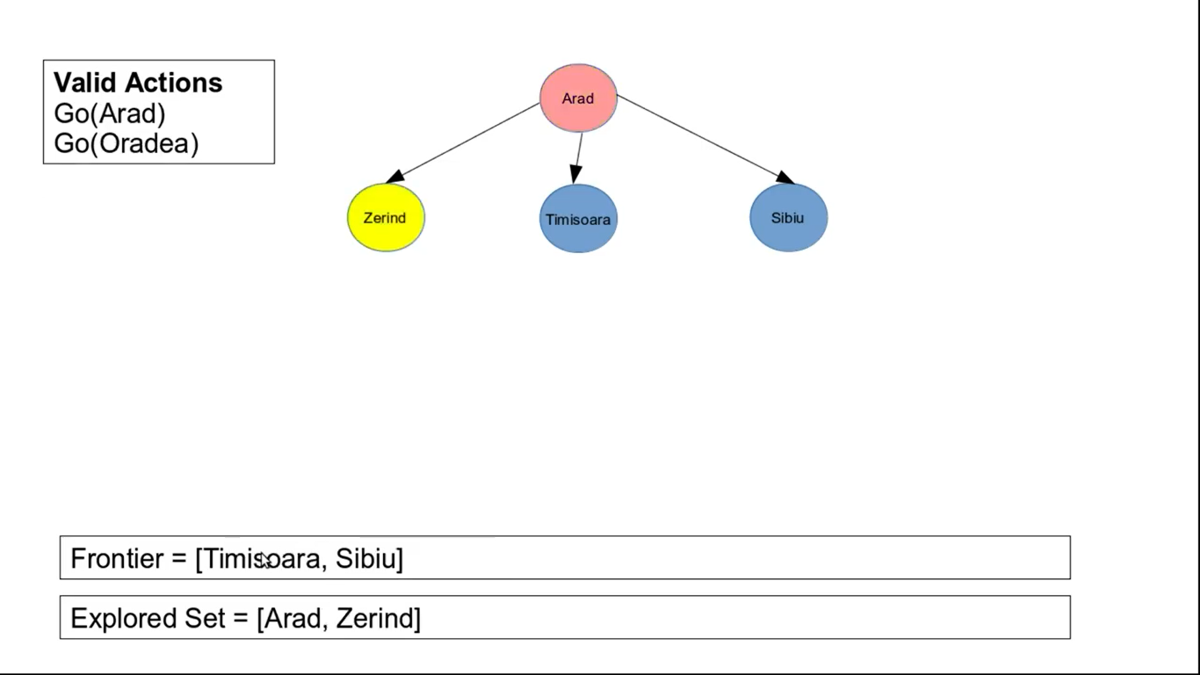

Slide 25
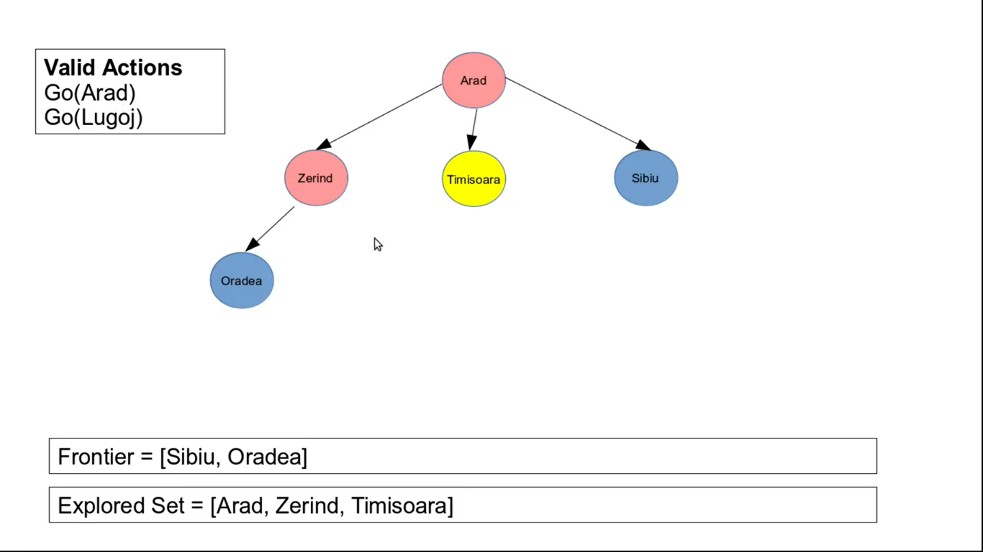
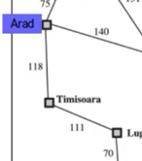

Slide 26
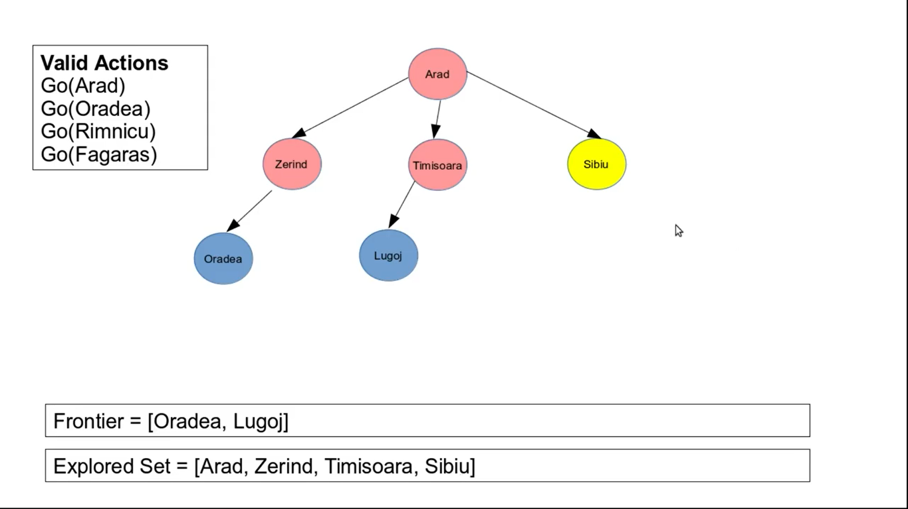
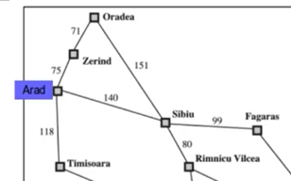

Slide 27
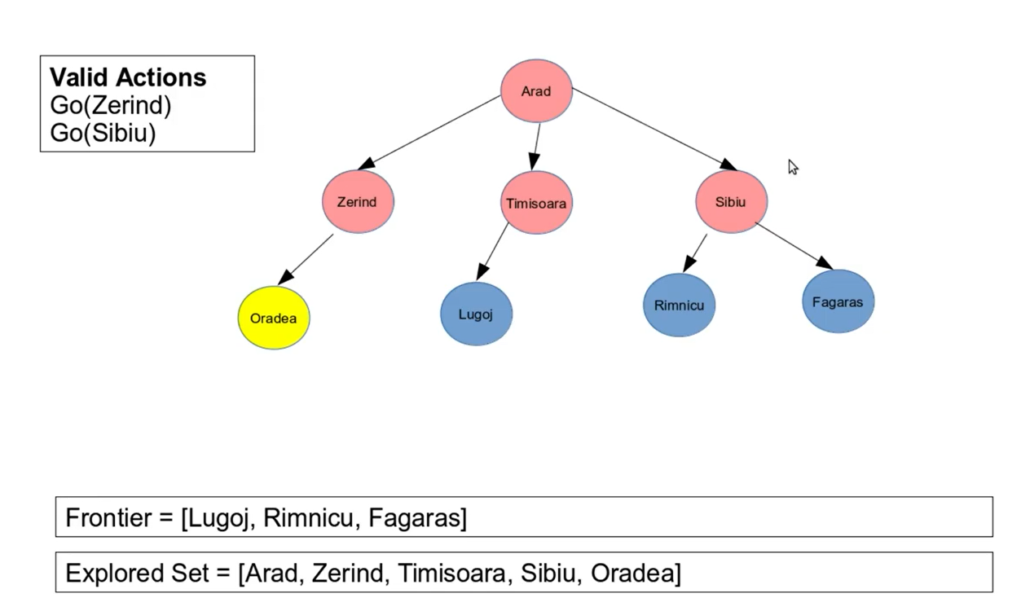

Slide 28
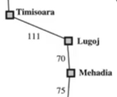
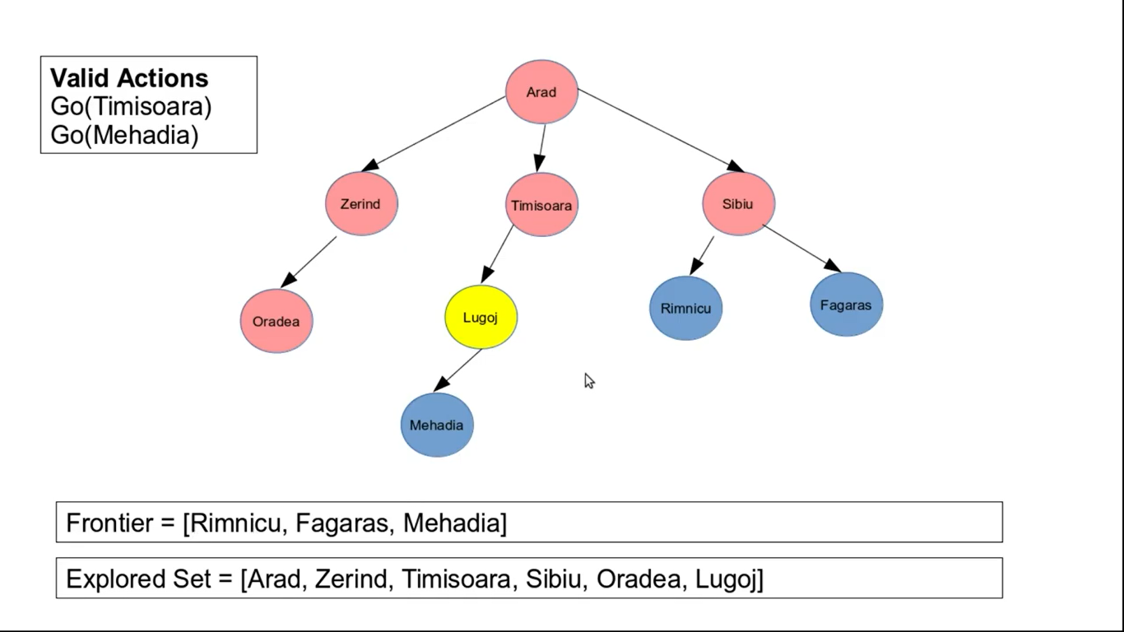

Slide 29
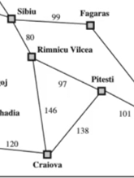
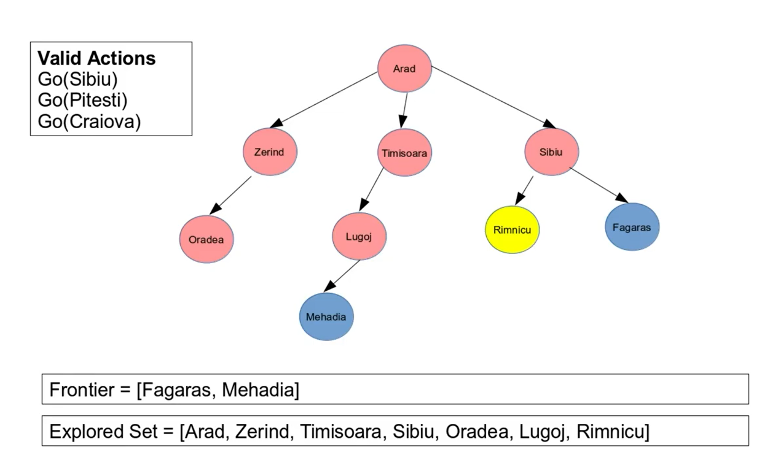

Slide 30
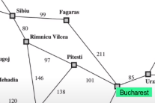
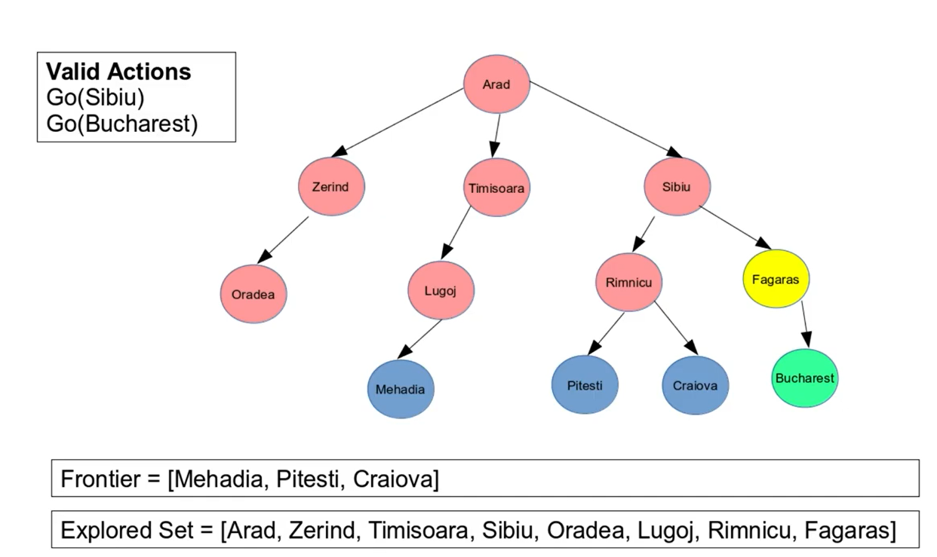

Slide 31
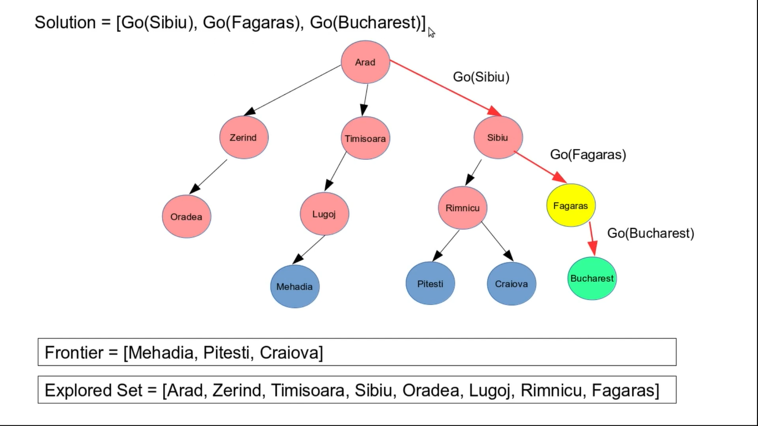

Slide 32
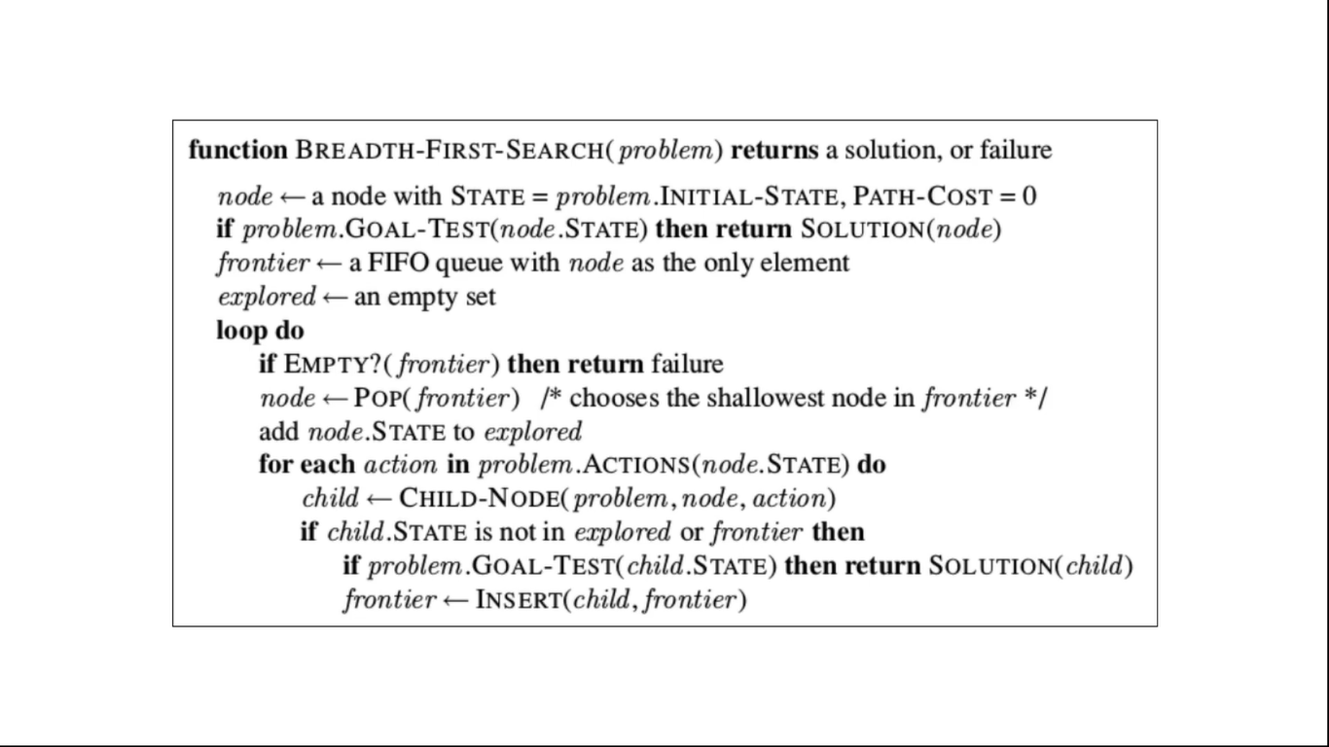

Slide 33
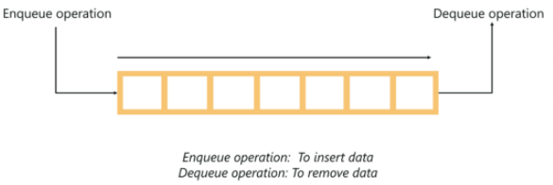
Cont…

Slide 34
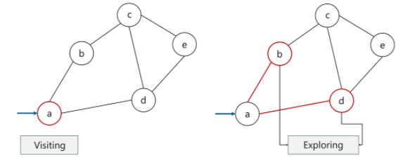
Cont…
Visiting a node: Just like the name suggests, visiting a node means to visit or select a node.
Exploring a node: Exploring the adjacent nodes (child nodes) of a selected node.

Slide 35
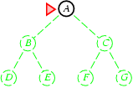
Breadth-first search
Expand shallowest unexpanded node
Implementation:
fringe is a FIFO queue, i.e., new successors go at end

Slide 36
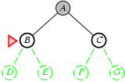
Breadth-first search
Expand shallowest unexpanded node
Implementation:
fringe is a FIFO queue, i.e., new successors go at end
EDC

Slide 37
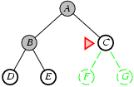
Breadth-first search
Expand shallowest unexpanded node
Implementation:
fringe is a FIFO queue, i.e., new successors go at end
GFED

Slide 38
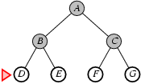
Breadth-first search
Expand shallowest unexpanded node
Implementation:
fringe is a FIFO queue, i.e., new successors go at end
GFED

Slide 39
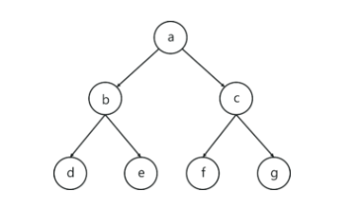
Example

Slide 40
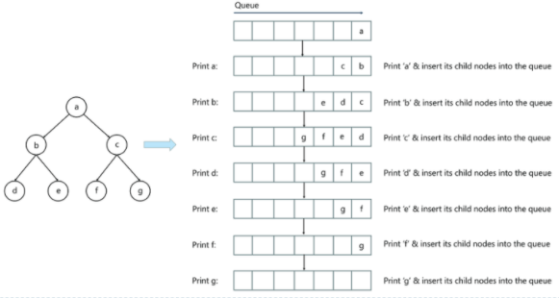
Solution

Slide 41

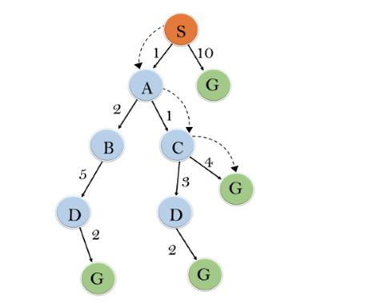
Properties of breadth-first search
Complete? Yes (if b is finite)
Time? 1+b+b²+b³+… +b^{d} + b(b^{d}-1) = O(b^{d})
Space? O(b^{d}) (keeps every node in memory)
Optimal? Yes (if cost = 1 per step)
Space is the bigger problem (more than time)

Slide 42
Advantages& Disadvantages
Advantages
BFS will provide a solution if any solution exists.
If there are more than one solutions for a given problem, then BFS will provide the minimal solution which requires the least number of steps.
Disadvantages
It requires lots of memory since each level of the tree must be saved into memory to expand the next level.
BFS needs lots of time if the solution is far away from the root node.

Slide 43
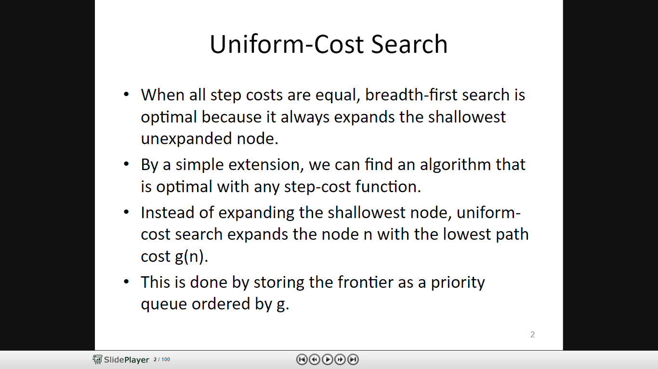

Slide 44
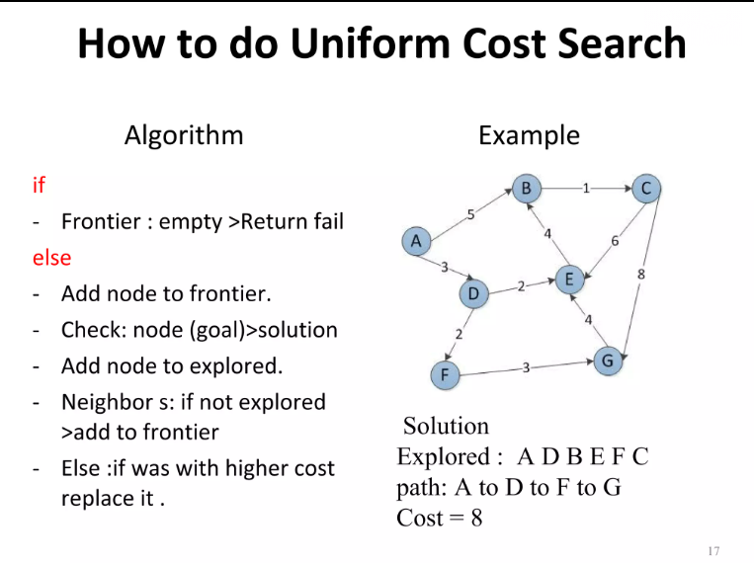

Slide 45
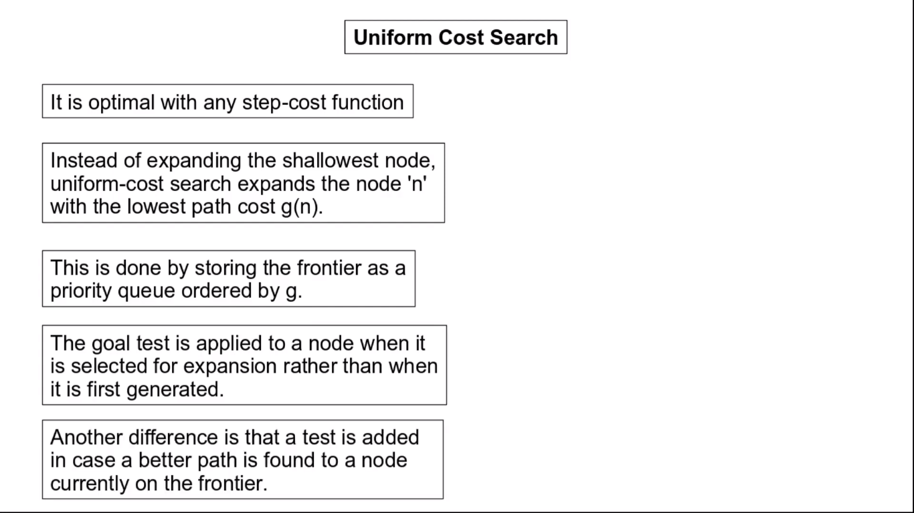

Slide 46
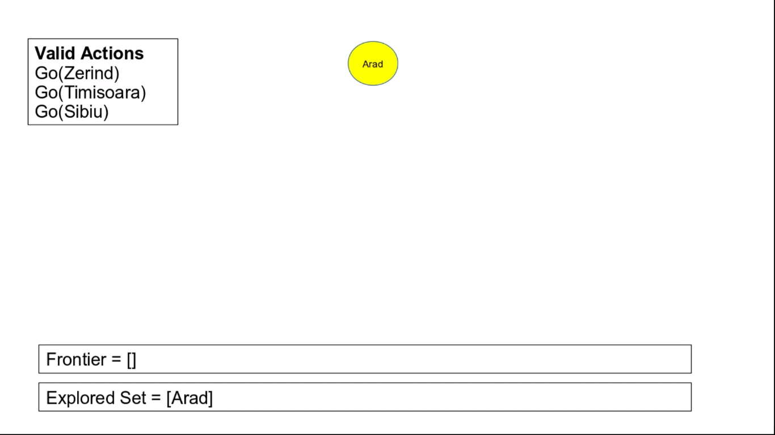
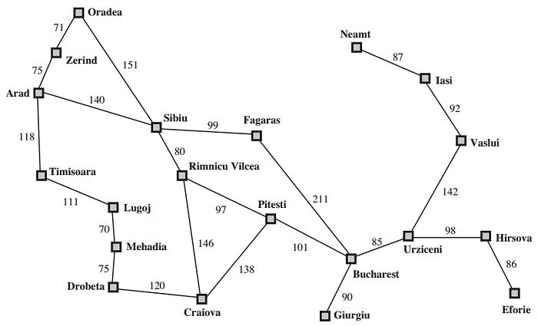

Slide 47
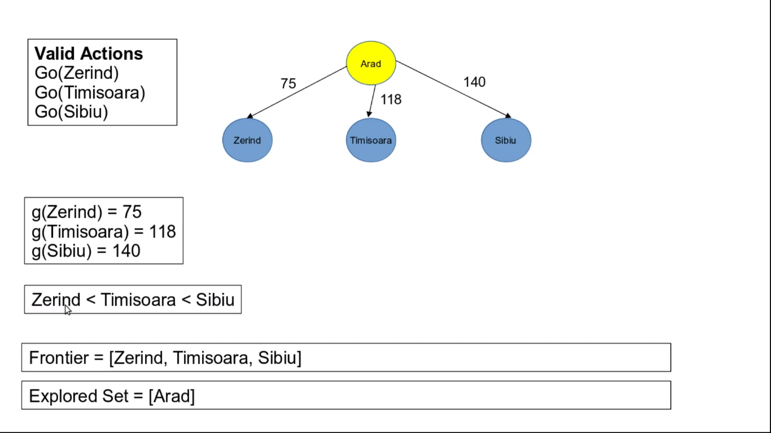

Slide 48
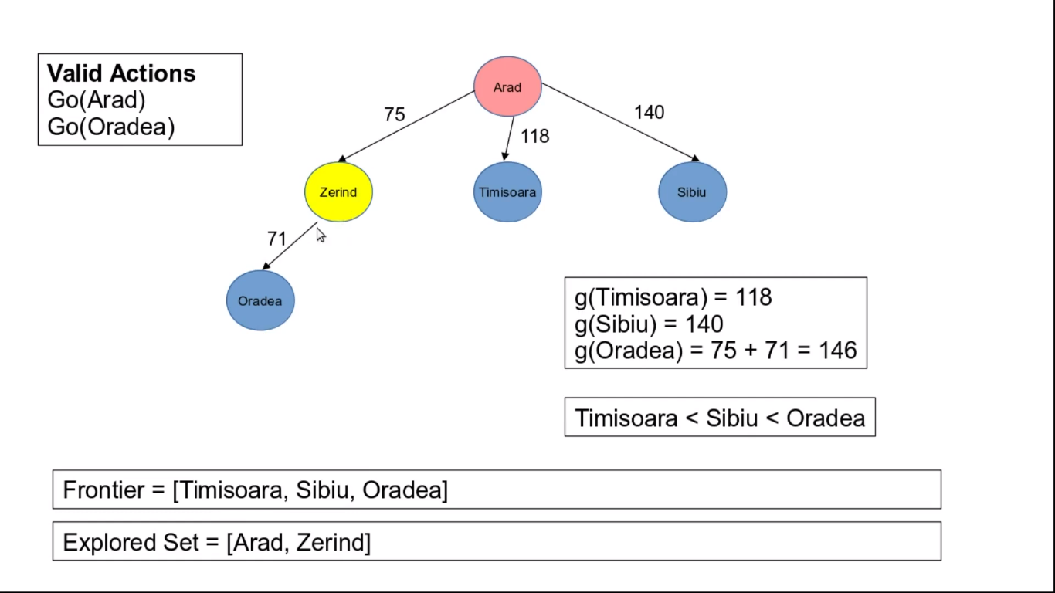

Slide 49
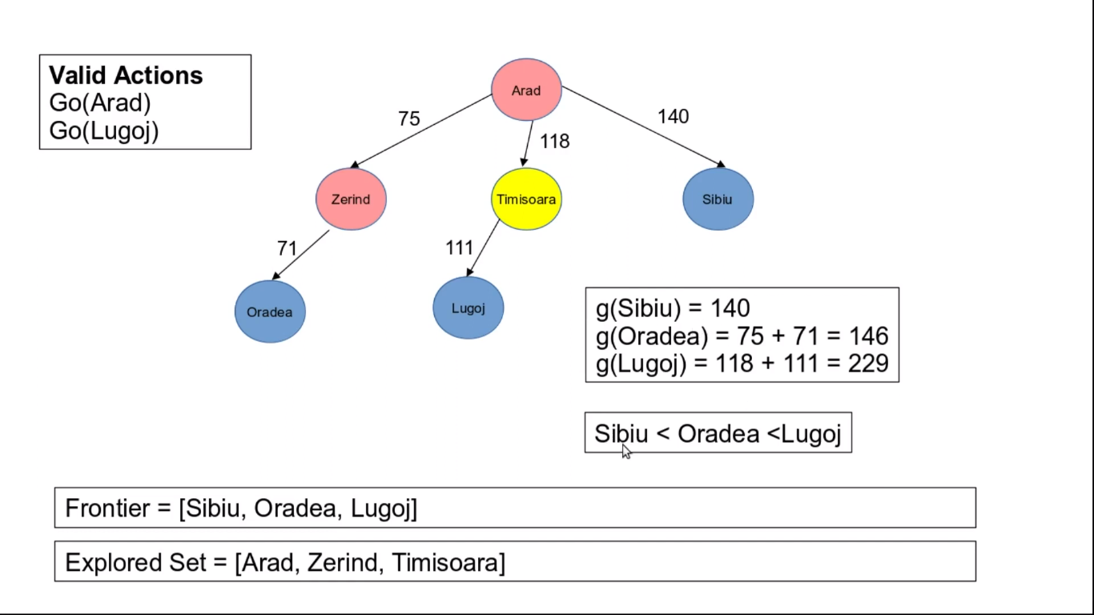

Slide 50
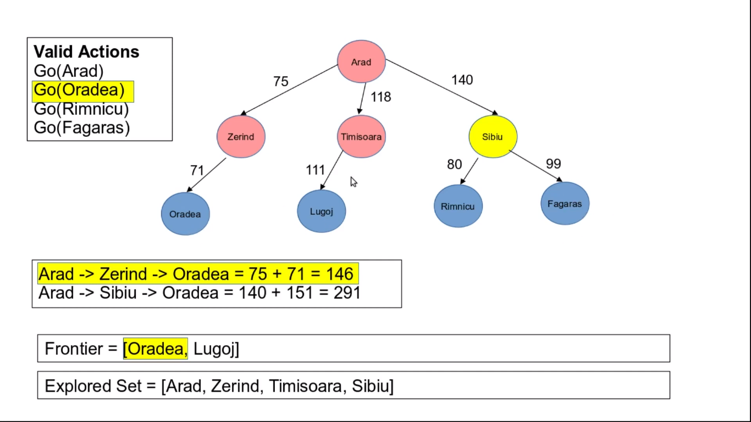

Slide 51
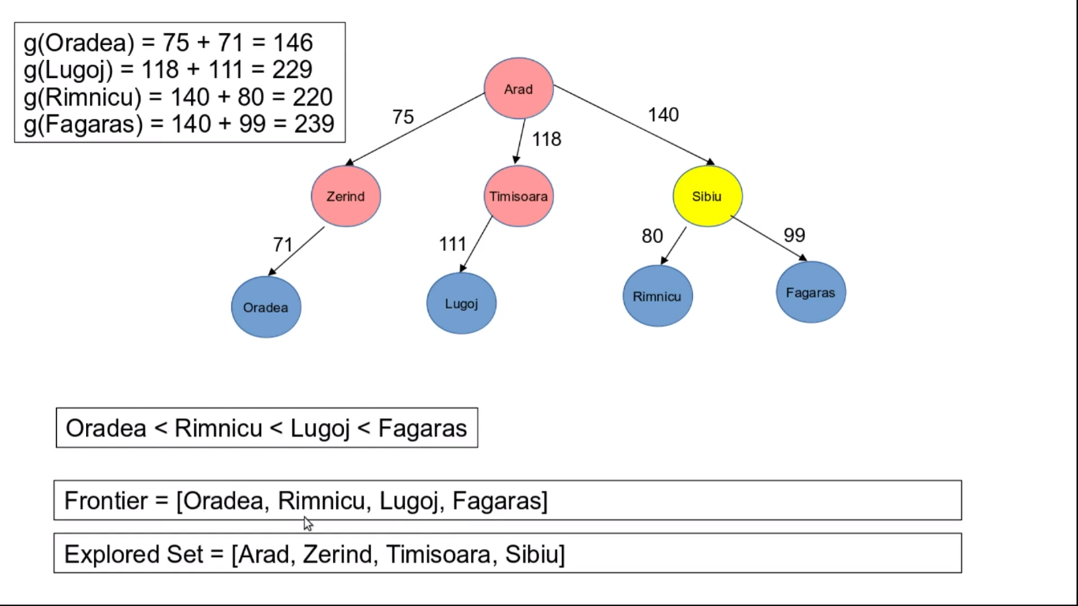

Slide 52
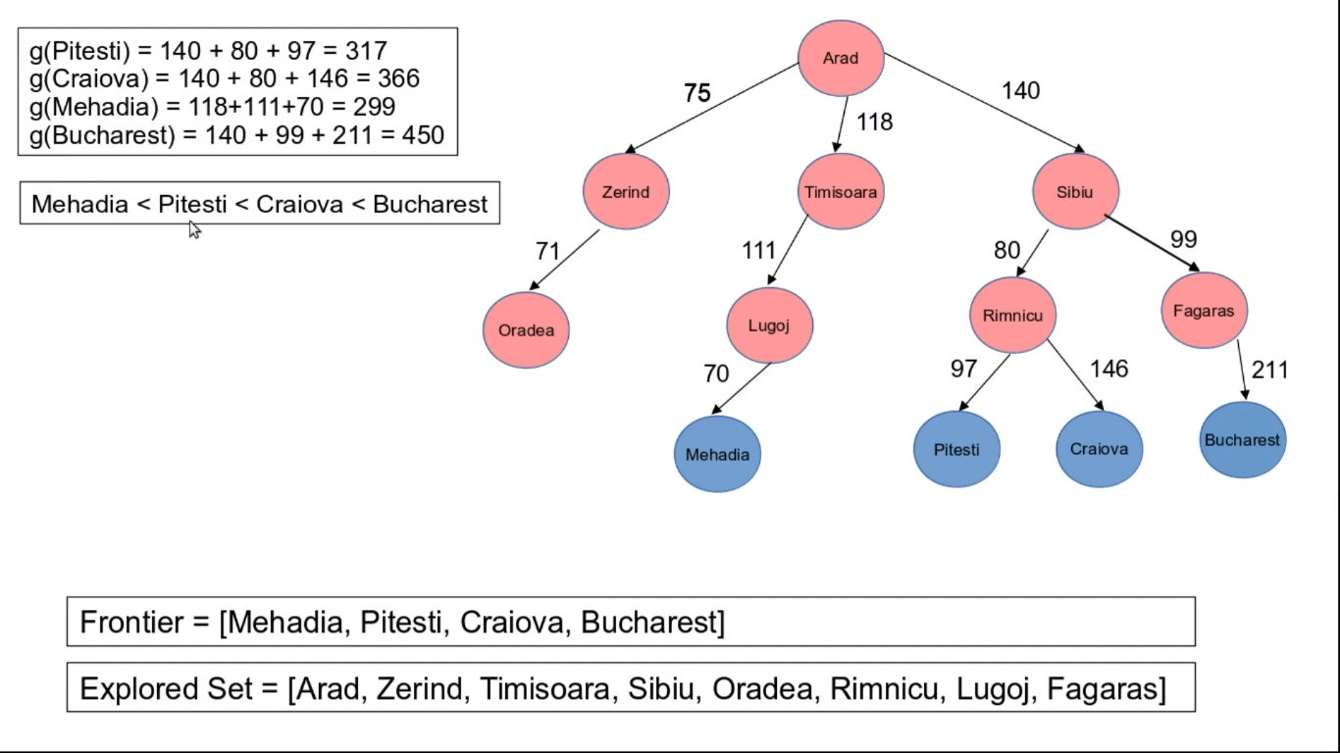

Slide 53


Slide 54


Slide 55


Slide 56


Slide 58

UCS

Slide 59

Depth-first search
Expand deepest unexpanded node
Implementation:
fringe = LIFO queue, i.e., put successors at front

Slide 60

Depth-first search
Expand deepest unexpanded node
Implementation:
fringe = LIFO queue, i.e., put successors at front

Slide 61

Depth-first search
Expand deepest unexpanded node
Implementation:
fringe = LIFO queue, i.e., put successors at front

Slide 62

Depth-first search
Expand deepest unexpanded node
Implementation:
fringe = LIFO queue, i.e., put successors at front

Slide 63

Depth-first search
Expand deepest unexpanded node
Implementation:
fringe = LIFO queue, i.e., put successors at front

Slide 64

Depth-first search
Expand deepest unexpanded node
Implementation:
fringe = LIFO queue, i.e., put successors at front

Slide 65

Depth-first search
Expand deepest unexpanded node
Implementation:
fringe = LIFO queue, i.e., put successors at front

Slide 66

Depth-first search
Expand deepest unexpanded node
Implementation:
fringe = LIFO queue, i.e., put successors at front

Slide 67

Depth-first search
Expand deepest unexpanded node
Implementation:
fringe = LIFO queue, i.e., put successors at front

Slide 68

Depth-first search
Expand deepest unexpanded node
Implementation:
fringe = LIFO queue, i.e., put successors at front

Slide 69

Depth-first search
Expand deepest unexpanded node
Implementation:
fringe = LIFO queue, i.e., put successors at front

Slide 70

Depth-first search
Expand deepest unexpanded node
Implementation:
fringe = LIFO queue, i.e., put successors at front

Slide 71

DFS

Slide 72


Properties of depth-first search
Complete? No: fails in infinite-depth spaces, spaces with loops
Modify to avoid repeated states along path
→ complete in finite spaces
Time? O(b^{m}): terrible if m is much larger than d
but if solutions are dense, may be much faster than breadth-first
Space? O(bm), i.e., linear space!
Optimal? No

Slide 73
Tree search example

Slide 74

WHY DFS in AI?

Slide 75

BFS

Slide 76

DFS

Slide 77


Slide 78
Depth-limited search
Similar to depth-first search with a depth limit l,
i.e., nodes at depth l have no successors
Depth-limited search can solve the drawback of the infinite path in the Depth-first search.
Depth-limited search can be terminated with two Conditions of failure:
Standard failure value: It indicates that problem does not have any solution.
Cutoff failure value: It defines no solution for the problem within a given depth limit.

Slide 79

Example

Slide 80

Depth Limited Search
Recursive implementation:

Slide 81
Cont…
Advantages
Depth-limited search is Memory efficient.
Disadvantages
Depth-limited search also has a disadvantage of incompleteness.
It may not be optimal if the problem has more than one solution.

Slide 82
Iterative Deepening DFS

Slide 83
Iterative deepening search
The problem with depth-limited search is deciding on a suitable depth parameter. To avoid this problem there is another search called iterative deepening search (IDS).
This search method tries all possible depth limits; first 0, then 1, then 2 etc., until a solution is found.
IDS may seem wasteful as it is expanding nodes multiple times. But the overhead is small in comparison to the growth of an exponential search tree
For large search spaces where is the depth of the solution is not known IDS is normally the preferred search method.
The following slide illustrates an iterative deepening search of 26 nodes (states) with an initial state of node A and a goal state of node L.

Slide 84
The example node set
Initial state
A
A
B
C
D
E
F
Goal state
G
H
I
J
K
L
L
M
N
O
P
Q
R
S
T
U
V
W
X
Y
Z

Slide 85
A
Node A is then expanded and removed from the queue.
We begin with our initial state: the node labeled A. This node is added to the queue.
A
As this is the 0th iteration of the search, we cannot search past any level greater than zero. This iteration now ends, and we begin the 1st iteration.
Size of Queue: 0
Size of Queue: 1
Size of Queue: 0
Queue: Empty
Queue: A
Queue: Empty
Nodes expanded: 0
Nodes expanded: 1
Current Action: Expanding
Current level: n/a
Current level: 0
ITERATIVE DEEPENING SEARCH PATTERN (0th ITERATION)

Slide 86
The search now moves to level one of the node set.
A
We again begin with our initial state: the node labeled A. Note that the 1st iteration carries on from the 0th, and therefore the ‘nodes expanded’ value is already set to 1.
A
B
B
C
C
D
D
E
E
F
F
Node A is expanded, then removed from the queue, and the revealed nodes are added to the front .
Node B is expanded and removed from the queue.
We now back track to expand node C, and the process continues.
As this is the 1st iteration of the search, we cannot search past any level greater than level one. This iteration now ends, and we begin a 2nd iteration.
Size of Queue: 0
Size of Queue: 1
Size of Queue: 5
Size of Queue: 4
Size of Queue: 3
Size of Queue: 2
Size of Queue: 1
Size of Queue: 0
Queue: Empty
Queue: A
Queue: B, C, D, E, F
Queue: C, D, E, F
Queue: D, E, F
Queue: E, F
Queue: F
Queue: Empty
Nodes expanded: 1
Nodes expanded: 2
Nodes expanded: 3
Nodes expanded: 4
Nodes expanded: 5
Nodes expanded: 6
Nodes expanded: 7
Current Action:
Current Action: Expanding
Current Action: Backtracking
Current Action: Expanding
Current Action: Backtracking
Current Action: Expanding
Current Action: Backtracking
Current Action: Expanding
Current Action: Backtracking
Current Action: Expanding
Current level: n/a
Current level: 0
Current level: 1
Current level: 0
Current level: 1
Current level: 0
Current level: 1
Current level: 0
Current level: 1
Current level: 0
Current level: 1
Current level: 0
Current level: 1
ITERATIVE DEEPENING SEARCH PATTERN (1st ITERATION)

Slide 87
We now move to level two of the node set.
A
Again, we expand node A to reveal the level one nodes.
A
We again begin with our initial state: the node labeled A. Note that the 2nd iteration carries on from the 1st, and therefore the ‘nodes expanded’ value is already set to 7 (1+6)
B
B
C
C
D
D
E
F
Node A is removed from the queue and each revealed node is added to the front of the queue.
G
G
H
H
I
I
J
J
K
K
L
L
L
L
L
L
The search then moves to level one of the node set. Press space to continue
Node B is expanded and the revealed nodes added to the front of the queue.
After expanding node G we backtrack to expand node H. The process then continues until goal state.
Node L is located on the second level and the search returns a solution on its second iteration.
Size of Queue: 0
Size of Queue: 1
Size of Queue: 5
Size of Queue: 6
Size of Queue: 5
Size of Queue: 4
Size of Queue: 5
Size of Queue: 4
Size of Queue: 3
Size of Queue: 4
Size of Queue: 3
Size of Queue: 0
Queue: Empty
Queue: A
Queue: B, C, D, E, F
Queue: G, H, C, D, E, F
Queue: H, C, D, E, F
Queue: C, D, E, F
Queue: I, J, D, E, F
Queue: J, D, E, F
Queue: D, E, F
Queue: K, L, E, F
Queue: L, E, F
Queue: Empty
Nodes expanded: 7
Nodes expanded: 8
Nodes expanded: 9
Nodes expanded: 10
Nodes expanded: 11
Nodes expanded: 12
Nodes expanded: 13
Nodes expanded: 14
Nodes expanded: 15
Nodes expanded: 16
Current Action:
Current Action: Expanding
Current Action: Backtracking
Current Action: Expanding
Current Action: Backtracking
Current Action: Expanding
Current Action: Backtracking
Current Action: Expanding
Current Action: Backtracking
Current Action: Expanding
Current Action: Expanding
Current Action: Backtracking
SEARCH FINISHED
Current level: n/a
Current level: 0
Current level: 1
Current level: 2
Current level: 1
Current level: 2
Current level: 1
Current level: 0
Current level: 1
Current level: 2
Current level: 1
Current level: 2
Current level: 1
Current level: 0
Current level: 1
Current level: 2
Current level: 1
Current level: 2
ITERATIVE DEEPENING SEARCH PATTERN (2nd ITERATION)

Slide 88


Iterative Deepening Depth-First Search

Slide 89

Find the route from S to G using BFS.
6

Slide 90
Example for illustrating uninformed search strategies
S
3
8
1
A
B
C
3
15
7
20
5
D
E
G

Slide 91

Example

Slide 92

Summary of algorithms

